Slide 1
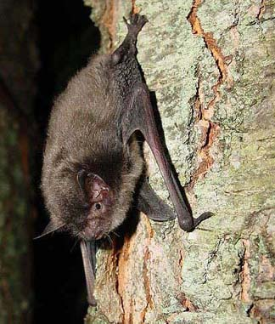

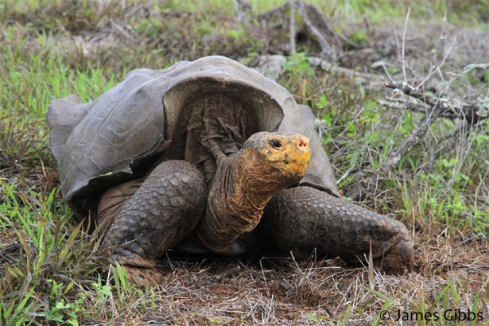
Advancing conservation with Bad Data!
Kevin Shoemaker, NRES
Notes:
Hi, I’m Kevin Shoemaker, a new wildlife population ecologist in NRES.
First of all, I’m really happy to be here- thanks to professor Stoughton for inviting me to talk today.
I am a conservation biologist. Conservation biology is an applied field- our goal is to advance the practice of conservation using the best available scientific evidence. So my job is to use evidence, or data, to figure out the best way to maintain large, healthy populations of threatened and endangered species. However, the data are not always clear, and sometimes the data are downright bad- and I’ll explain what I mean by “bad”. Unfortunately, bad data is not the exception- it is the rule! And you can see this as an annoying problem, but I like to see it as a fun challenge! My specialty is to find ways to use bad data to address important conservation issues.
This I hope will illustrate a basic fact of ecological research, and in many ways science in general. It is not linear, it is messy. It is not prescriptive, like a typical high school science lab- it is an intensely creative activity.
Today I’ll share two examples of this- in the population viability of Galapagos tortoises and the impact of wind energy on the Indiana bat in the eastern US.

Slide 2
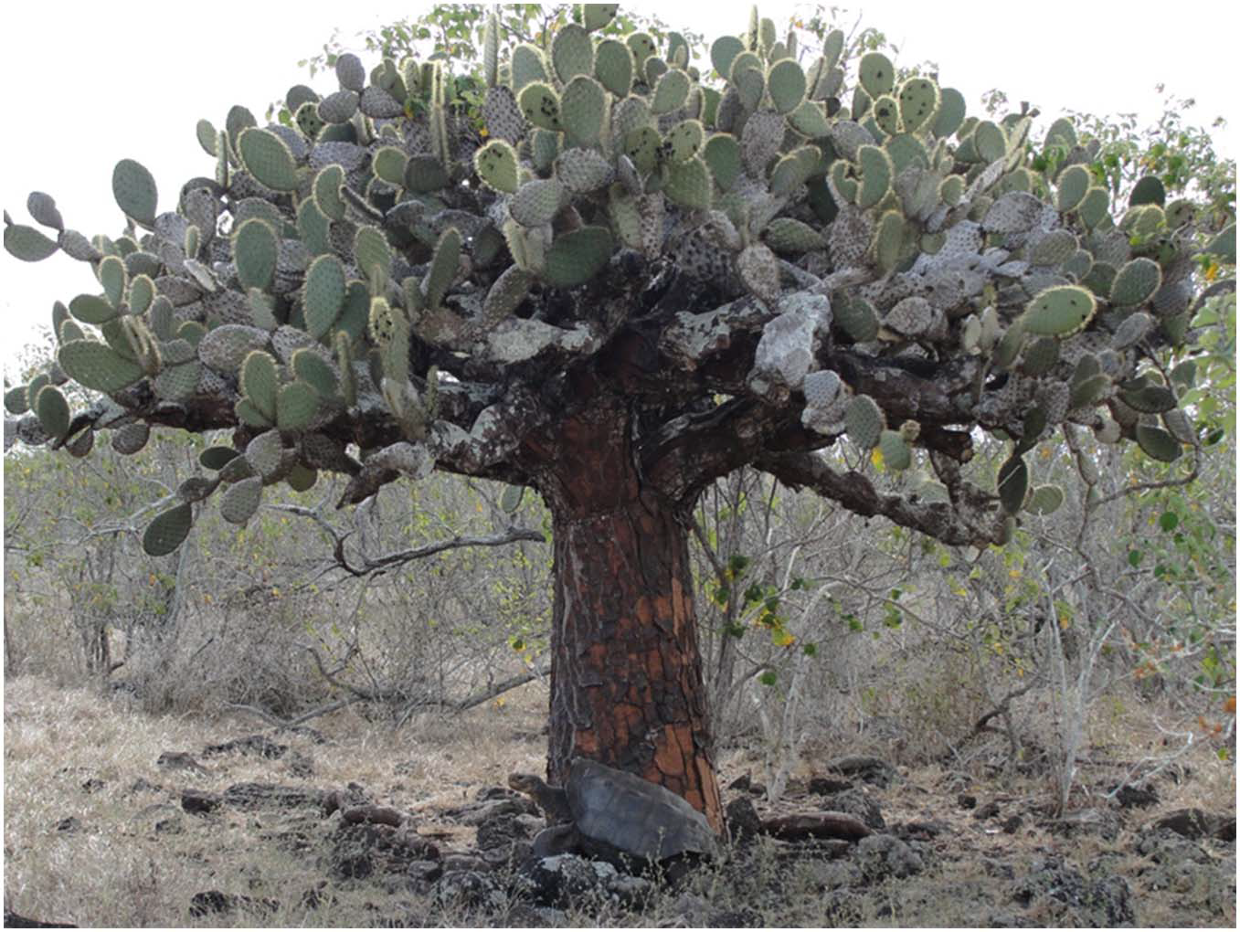
Bringing giant tortoises back to Espanola island, Galapagos
Photo: James Gibbs
Notes:
One example of this from my research is my work with documenting the success of the repatriation of the Espanola tortoise on Espanola island in Galapagos.
[click] By the way, there is a tortoise in this picture!

Slide 3
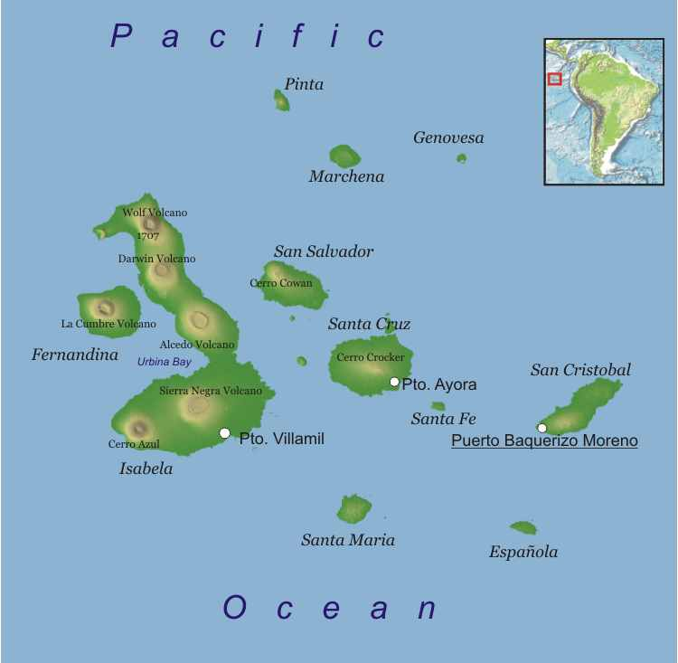
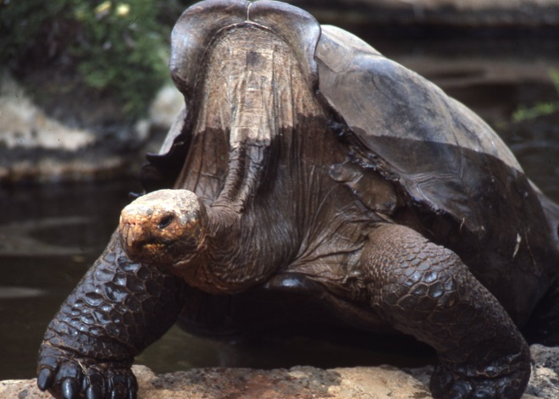
Espanola data: the good and the bad
Española island reintroduction project
Population crashed due to hunting and goats
The good: between 1963 and 1974, all 15 survivors were captured and since 1975 >1500 of their offspring released- and monitored!
The bad: new marking system introduced in 1991
Notes:
Just for geographical reference- here is espanola island- the oldest of the remaining islands in Galapagos.
Like many Galapagos tortoise subspecies, the Espanola tortoise was nearly hunted out of existence by whalers and pirates in the 19th century.
Then, in the 20th century, feral goats competed with tortoises for food resources.
In the 1960s and 1970s, all 15 remaining tortoises (mostly females) were removed from the island for captive breeding. Since 1975, over 1500 animals have been released.
And amazingly, the population has been monitored from the very beginning of this repatriation effort.
So why is this data set “bad”? Well, it has to do with the marking system they used. From 1975 to 1991, researchers notched and branded the tortoise shells with individually recognizable markings. This system worked beautifully.
Then, some brilliant individual said, hey, everyone is starting to adopt this PIT tag technology to mark animals- let’s switch over! And so they switched. And immediately stopped recording the previous notch codes.
If you have done any capture mark recapture work, you know that it is an incredibly RICH source of data- when you can track the history of each individual over a long period. ESPECIALLY when this is an animal that can live well over 100 years of age.
You might ask, why don’t they just go out and rectify this situation? Well, it’s just not that easy. For multiple reasons.
It’s a shame- But is it a complete loss?

Slide 4
“Hacking” a solution
Divide dataset into pre- and post-PIT tag years
Reconstruct complete observation histories
Use common sense (e.g., individuals can’t change gender or shrink dramatically in size!)
Break “ties” in a way that doesn’t magically bring tortoises back from the dead!
Pre-PIT
Post-PIT
Data issues scared away several previous researchers!
 | Year 1 | Year 2 | Year 3 | Year 4 | Year 5
Tortoise #1 | released | not seen | not seen | not seen | not seen
Tortoise #2 | released | not seen | not seen | not seen | seen
 | Year 6 | Year 7 | Year 8
Tortoise #?? | seen | not seen | not seen
Notes:
Not necessarily!
My solution- which was not particularly elegant- was to first divide the data set into pre and post PIT tag years.
Then I reconstructed a master capture history database probabilistically. For each “Post-PIT” individual, I first constrained the set of plausible matchups on the basis of other covariables, like size, age, and sex.
I then developed an algorithm for linking the two data sets probabilistically in such a way as to avoid “magically bringing dead tortoises back to life”.
What do I mean? Well, if I was trying to link this POST dataset with one of these two PRE datasets, I would pretty much always link it to the second capture history- because there is a much greater chance that the second tortoise is still alive than the first tortoise. If I linked this POST-PIT tortoise with the first pre-pit tortoise, I could very well be “resurrecting” tortoises from the PRE-PIT dataset and thereby inflating survival rates. This way, we can generate a large set of plausible reconstructed datasets.
Okay, I get it- not elegant, but that is the point! Several researchers had shied away from this data set previously. And with the hacked solution, we could recover some really important information that we wouldn’t otherwise have had access to.

Slide 5
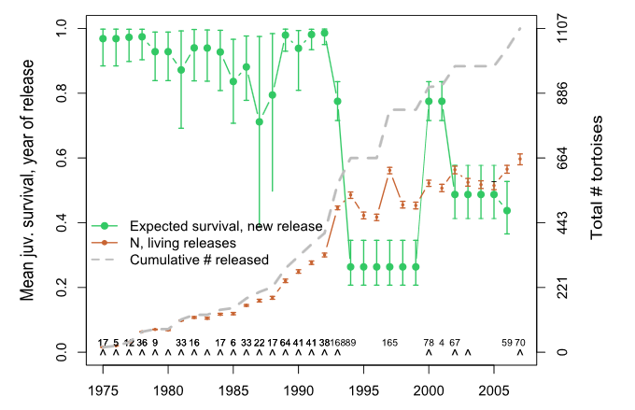
Notes:
Even more importantly: that we have reconstructed the mark recapture dataset, we can reconstruct the entire history of the tortoise repatriation program on Espanola island in Galapagos.
First of all, the green indicates survival of newly released juveniles. Clearly, the survival of new releases is high originally and drops off, potentially due to some density dependent effects.
I should note that survival of adults and subadults was uniformly high- around 97% and is not pictured here.
The grey line indicates the cumulative number of captive-reared tortoises released, and the red is an estimate of the total number of these that are still alive.
[click] The current estimate is that about 700 of the repatriates are still alive and doing pretty well.
So a reconstruction of the re-tortoising of an island- pretty cool!

Slide 6
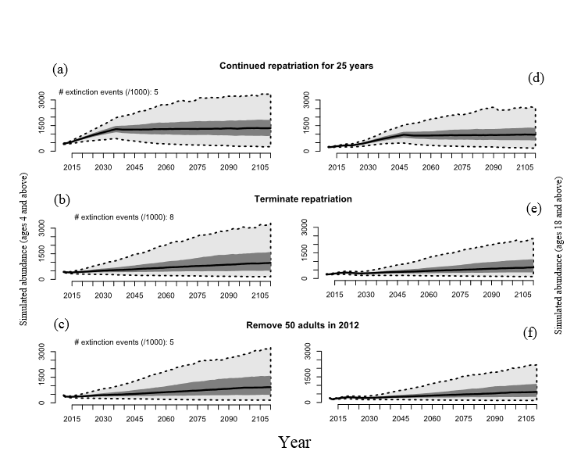
Continue repatriation for 25 years
Total abundance
Adult abundance
Terminate repatriation now
Notes:
Even more importantly, with a fitted model of the reconstructed history of repatriation, we can now use hacker tool #2, simulating data from models, and evaluate some alternative conservation strategies.
In particular, we can evaluate whether or not it might make sense to stop the expensive captive breeding and repatriation program at Espanola, or continue for another 25 years.
We find that population viability is very high either way, at least over the next hundred years or so, and in that case the program can be called a success.
In fact, our paper was picked up by many news outlets, and this story is the only one they picked up on. A major conservation success story! Certainly helped to provide a counter to the depressing news that lonesome George- the last hope for his species – had just been mounted in a permanent exhibit at NYC’s AMNH. One subspecies lost, another saved!
[click] However, this isn’t exactly the story we were telling in our paper. From an ecological standpoint, it’s the adults that have the greatest impact on restoring the vegetation- tortoises are ecological engineers!
In this way, continued repatriation could have ecological benefits by jumpstarting the adult population.

Slide 7
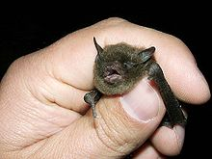
Assessing Population-level Risks of Wind Power Development for the Indiana bat (Myotis sodalis)
Notes:
Earlier this year we were given the task of developing a model to assess the population-level impacts of new wind power facilities on the endangered Indiana bat in the eastern United States.

Slide 8
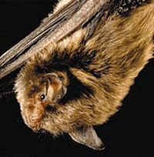
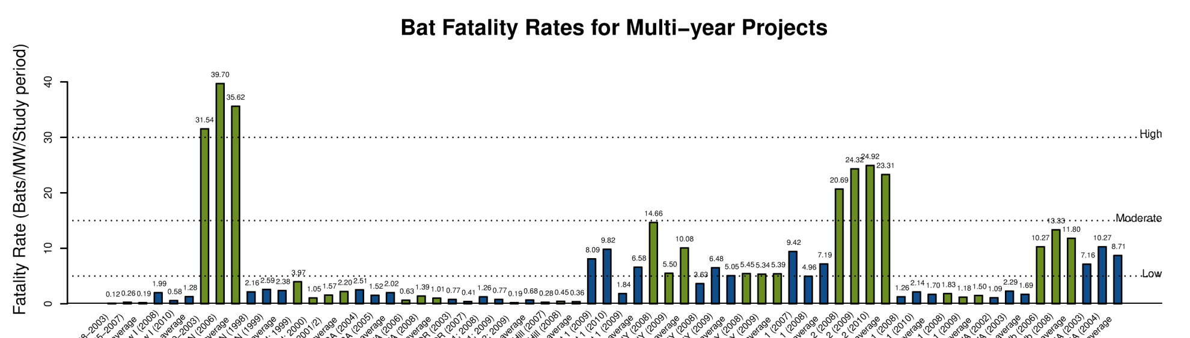
Wind power and bats
Turbine-related bat fatalities
2003: 400+ turbine fatalities observed in WV
BUT: only 4 Indiana bat fatalities have ever been observed
WEST 2011: AWEA response to USFWS Wind Energy Guidelines
Notes:
Why would we think Indiana bat populations might be at risk from wind power development? Studies of turbine-related fatalities have yielded unexpectedly high numbers of bat carcasses, raising concerns from government, private citizens, interest groups, and industry. Interestingly, in the eastern US the species observed in the highest numbers are nearly always the migratory tree bats such as the hoary bat. Generally lower fatality rates have been observed for bats of the Myotis genus, such as the Indiana bat. In fact, only 3 turbine-related Indiana bat fatalities have been reported to date. This figure, compiled by Western EcoSystems Technology, illustrates the total observed bat fatality rate per MW per year. The x axis lists sites at which post-construction fatality studies have been conducted and the height of the bars indicates the estimated number of bats killed per megawatt per year. Clearly, the rate of bat fatalities varies dramatically among sites. The highest rates are typically recorded in the eastern US, particularly the appalachian ridges.

Slide 9
Putting fatalities in context
A population-level approach
With wind farms
Without wind farms
Probability
of decline
Years from present
Notes:
So its clear that bats are killed by wind turbines. But the real question is what these deaths mean to the populations or species, not individual bats. In this project we are attempting to use a population level approach to link expected numbers of bat fatalities to expected risk of population decline or extinction. How severe or inconsequential are turbine-related fatalities likely to be? We have built our reputation at Applied Biomathematics upon undertaking population-level risk assessments to assess this type of question. Ultimately we can develop risk curves which depict the degree to which wind farms increase the risk of adverse population-level effects.

Slide 10
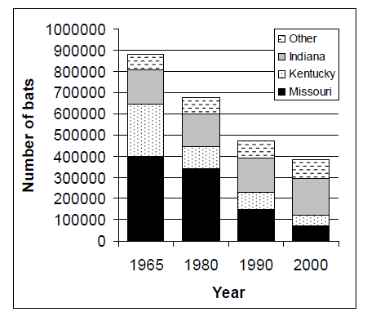
Indiana bat: background
IUCN: Endangered
USFWS: Endangered
Threatened by
Loss of hibernacula?
Loss of summer foraging/roosting habitat?
Disease: “white nose” syndrome?
Wind power development?
From USFWS 2009 recovery plan, 5-year review
Notes:
The Indiana bat is a species of high conservation concern, listed as Endangered by national and international authorities. This species has apparently been in decline since at least the middle part of the last century and probably before that. Based on paleontological records from cave hibernacula Indiana bats likely numbered in the tens of millions prior to European colonization. Primary early threats to Indiana bats were loss of hibernacula to disturbances such as saltpeter mining. In addition, agriculture and other development has changed the character of the landscape through much of the historic range of the species, and likely reduced summer foraging and roosting habitat. In addition, a fungal disease called white nose syndrome has been devastating populations of cave dwelling bats including Indiana bats among others. Finally, there is some concern that wind farms might pose a severe risk to Indiana bats, especially in conjunction with the cumulative effects of the threats listed above.

Slide 11
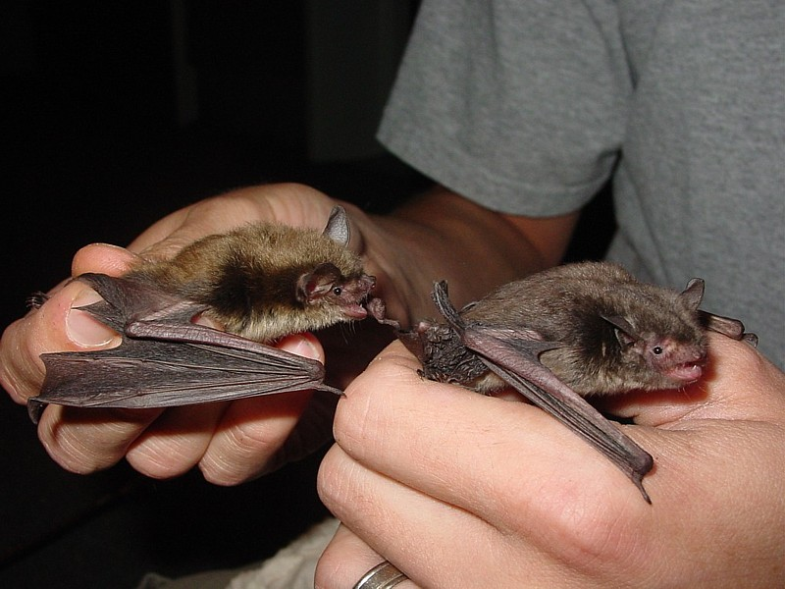
Notes:
The range of the Indiana bat includes much of the midwest, appalachia, eastern US and great lakes region. The USFWS has divided the range of the Indiana bat into four ecologically-distinct recovery units: the Ozark-central, Midwest, Appalachian, and Northeast.
Just a quick introduction to the ecology of the species. Indiana bats spend their winters in caves and mines. Indiana bat habitat needs include: forested deciduous wetlands, ample forest edges, and insect-rich meadows and streams. I will come back to these critical habitat features when I discuss the modeling approach.

Slide 12
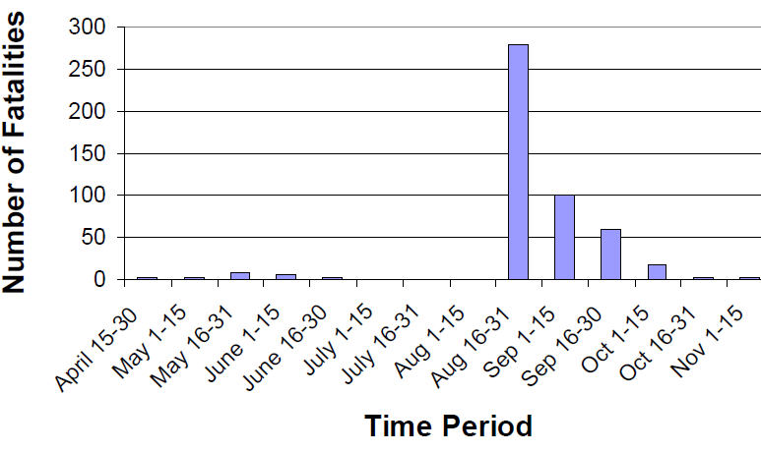
Focus on fall migration
Nearly all turbine-related bat fatalities are observed during late summer and early fall during migration season
All 3 Indiana bat fatalities have been observed in late September
Birth
WEST 2004: Mountaineer report
April-June
Return to roost sites
Pre-Weaning
June - August
Spring migration
Post-weaning
Fall migration
Hibernation
Swarming/mating
August September
Notes:
I don’t have time to go into detail about the Indiana bat life history. For our purposes it will suffice to focus on fall migration. The vast majority of bat kills in general- almost across the board- are in the fall. This figure illustrates this pattern from a WV wind power site.
This seems to hold for indiana bats as well, although only 3 observed indiana bat fatalities have been directly attributable to wind power development. However, all of these fatalities have been observed in late September, as bats are returning to hibernacula.

Slide 13
Regional hardwood forest availability
Density of deciduous forests within 2 km radius
Based on data from MRLC National Land Cover Database (NLCD)
Notes:
Well, we only have 4 known fatalities to work with, but that doesn’t mean that no data are available to address this problem- we just have to think a little bit.
Most importantly, the Indiana bat is a resident of deciduous forests. Therefore, we obtained GIS data on the location of deciduous forests from the MRLC NLCD database.

Slide 14
Regional forest/field edge density
Density of forest edges within 2 km radius
Based on data from MRLC National Land Cover Database (NLCD)
Notes:
Many experts have noted that the indiana bat tends to forage along forest edges and tends to roost in areas of high edge density. Therefore, we derived a forest edge density map using data from the NLCD database.

Slide 15
Forest age
Forest age (180 m grid cell)
Based on data available from ORNL/NASA
Notes:
The indiana bat roosts in large trees with peeling bark, which are only present in older forests. Therefore, we compiled a map of forest age, based on data from Oak Ridge National Laboratory using Landsat satellite data as well as other data sources.

Slide 16
Regional wetland density
Density of wetlands within 2 km radius.
Based on data from National Wetlands Inventory (USFWS)
Notes:
The Indiana bat is generally associated with lowlands and wetlands. Therefore, we compiled a map of wetland density based on data from the national wetlands inventory.

Slide 17
Regional stream density
Density of streams within a 2 km radius.
Based on data from National Hydrography Dataset (USGS)
Notes:
Bats in general tend to forage along streams as well as fields and forest edges. Therefore, we compiled a stream density layer based on data from the national hydrography dataset.

Slide 18
Diversity of foraging habitat
Number of distinct foraging habitat types available
Based on data from MRLC National Land Cover Database (NLCD)
Notes:
The indiana bat is insectivorous, and seems to prefer roosting in areas relatively near to a wide array of potential insect-producing habitats such as streams, lakes, meadows, and agricultural fields.

Slide 19
Distance from Hibernacula
Digitized from USFWS Recovery Plan (2007)
Notes:
Finally, indiana bats can migrate long distances, but quality areas near hibernacula are more likely to be used than areas far from hibernacula. Therefore, we will use the distance from nearest hibernaculum as part of our habitat suitability algorithm.

Slide 20
Inferred summer roost sites
Inferred roost areas must meet all criteria for suitable habitat
Notes:
Finally, we combined all habitat suitability layers into a single map of overall habitat suitability. We will continue to consult with experts and published literature to refine the algorithm. For now, we just normalized each component layer to the same scale and added them up.

Slide 21
Inferred summer roost sites
Inferred roost areas must meet all criteria for suitable habitat
Notes:
Finally, we will combine all habitat suitability layers into a single map of overall habitat suitability. We will consult with experts and published literature to refine the algorithm. For now, we just normalized each component layer to the same scale and added them up.

Slide 22
Inferred summer roost sites
Inferred roost areas must meet all criteria for suitable habitat
Notes:
Finally, we will combine all habitat suitability layers into a single map of overall habitat suitability. We will consult with experts and published literature to refine the algorithm. For now, we just normalized each component layer to the same scale and added them up.

Slide 23
Map of “resistance” to bat movement
Notes:
When we put all the component maps together, this is what we get. Note the darker dots, which represent cities. Indiana bats are thought to travel around rather than through cities…

Slide 24
3) Infer density of migrating bats
NOTE: wind farm locations from ORNL, includes sites currently in development
Density of migrating bats across the Ozark-central recovery unit
Notes:
To put all this information together, we used circuitscape software, which uses electrical circuit theory to model animal movements. For this project, we are modeling fall migration. Therefore, we use the summer roost sites as current sources and we use the hibernacula as electrical grounds. The software accepts the sources, grounds, and the resistance map shown in the previous slide. The software then computes the total current flowing through each grid cell in the landscape (in this case, around 15 million grid cells).
This is the a result from the Circuitscape analysis for the Ozark-central recovery unit.
Now we can overlay the wind facilities in order to connect the circuitscape analysis to our ultimate question of interest: what proportion of bats are likely to be flying through the wind farm footprint?

Slide 25
3) Infer density of migrating bats
NOTE: wind farm locations from ORNL, includes sites currently in development
Density of migrating bats across the Appalachian recovery unit
Notes:
Note that some wind farm locations appear to be located in some more important migration areas for indiana bats in this recovery unit.

Slide 26
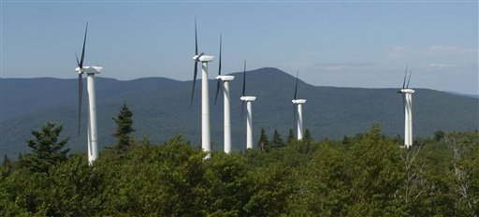
High impact site?
http://thedailyrecord.com
This facility in MD (under development) may intercept over 1% of all migrating bats in Appalachia Recovery Unit.
Notes:
Roth Rock site: far western MD on WV border.

Slide 27
4) Estimate % killed by wind farms
Population | # wind facilities | % population crossing wind farm boundaries | 10% killed by wind turbines annually | 1% killed by wind turbines annually
Ozark-central | 35 | 2.0% | 0.2% | 0.02%
Midwest | 25 | 2.7% | 0.27% | 0.03%
Appalachian | 25 | 4.3% | 0.43% | 0.04%
Northeast | 19 | 3.6% | 0.36% | 0.04%
Notes:
This is our current estimate of the total percentage of each indiana bat recovery unit likely to migrate through a wind farm facility in the fall. From this we computed a high and a low estimate of total annual wind-turbine mortaility by assuming that 10% or 1% of these individuals are killed.

Slide 28
Projected population-level impact of wind farms, risk of 95% decline
Population | # wind facilities | Initial Abundance | Baseline | 10% fatality scenario | 1% fatality scenario
Ozark-central | 35 | 70,822 | 0.3% | 0.5% | 0.4%
Midwest | 25 | 305,297 | 0.2% | 0.4% | 0.4%
Appalachian | 25 | 32,529 | 0.3% | 0.8% | 0.4%
Northeast | 19 | 16,060 | 0.1% | 0.4% | 0.4%
NOTE: Risk defined over a 50 year time frame
Notes:
It is simple to compute this using the circuitscape inputs and outputs. However, once we know the total population proportion flying through the wind farm footprints we must make a guess about the proportion of those individuals that are killed. We could conservatively guess that 100% or 50% are hit by turbines, although the true number is likely to be much lower. Based on this demonstration analysis, about 0.6% of the population would be killed if half of all individuals flying through wind farm footprints were killed.
NOTE: our model infers that about 2000 bats pass through the Fowler Ridge wind facility in Indiana each year. Only 3 indiana bats fatalities have been observed there: the only known Indiana bat fatalities. If we assume that the observed number represents only 5% of those actually killed, then we could infer that approximately 3% of those bats passing through the facility are killed. Here we assume for arguments sake that 10% of bats passing through each facility are killed.

Slide 29
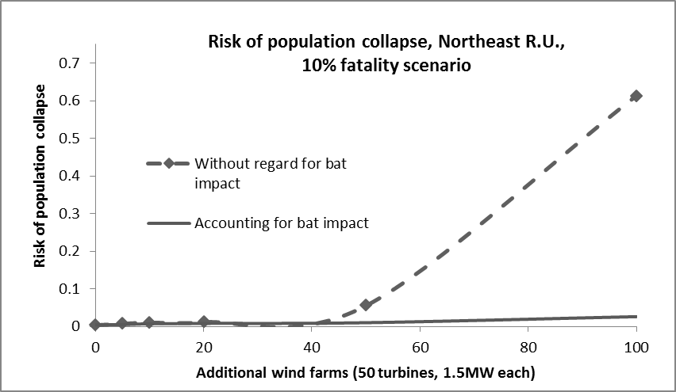
Risk to Indiana bats under future wind development

Slide 30
A tool for siting wind farms?

Slide 31
Questions?

